Slide 1
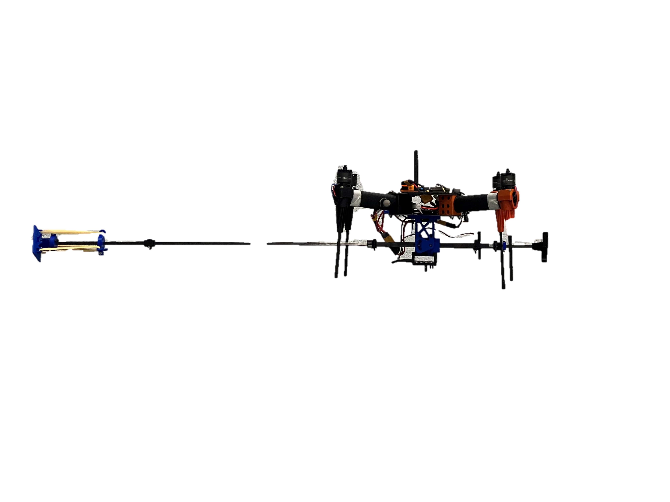
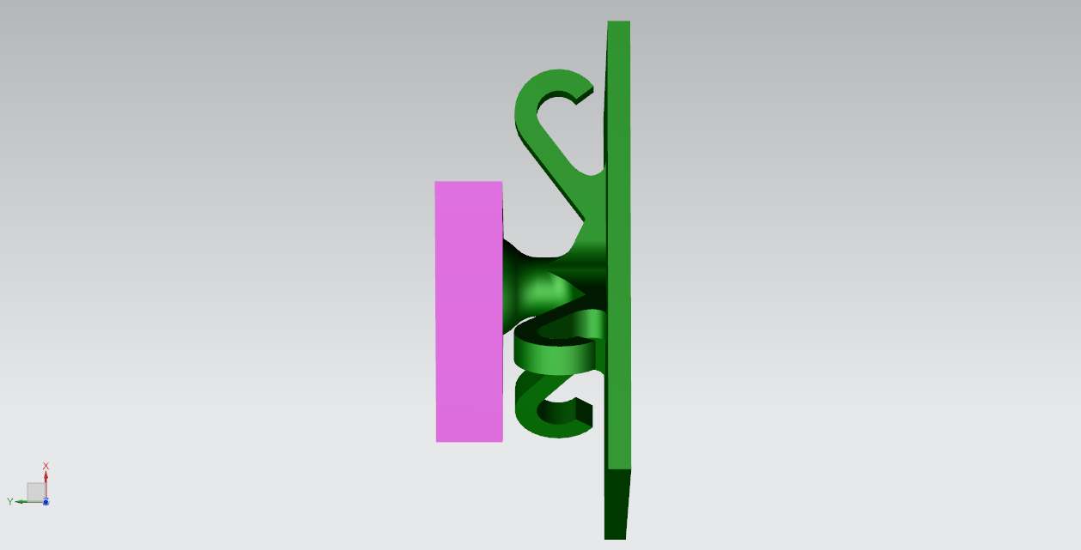
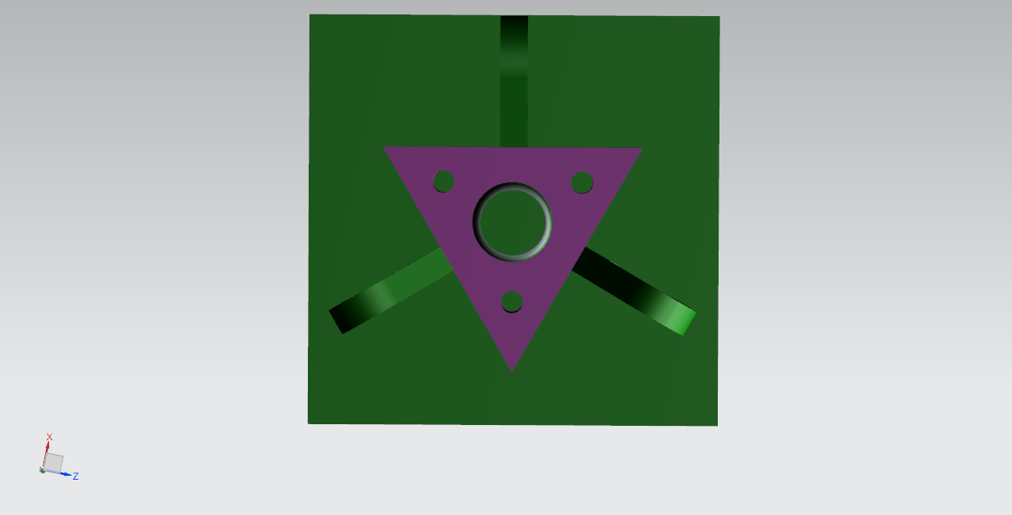
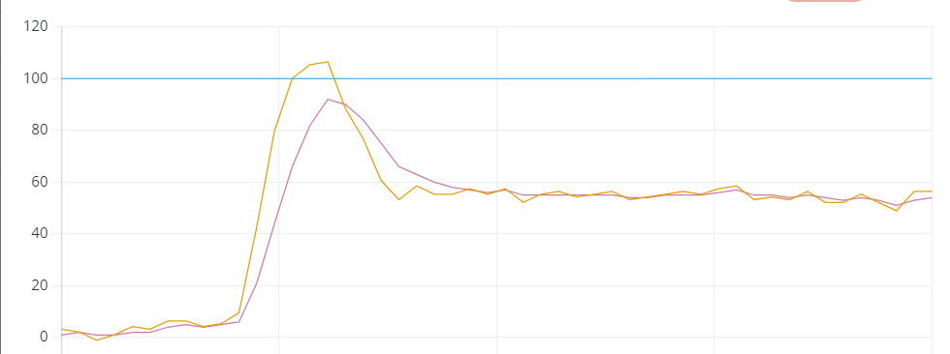

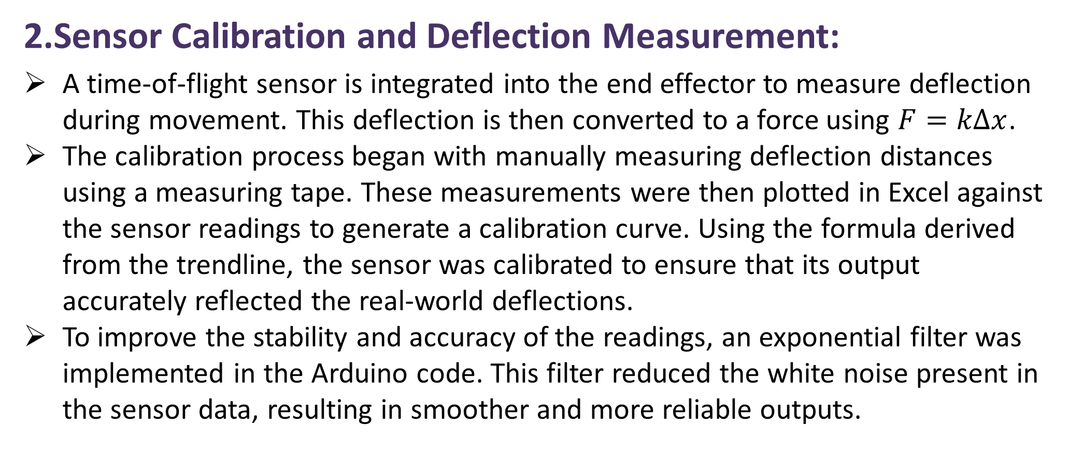
Mechanical Arm for Aerial Manipulation Tasks
Introduction
Aerial manipulation using robotic arms is a growing area of research with applications in search and rescue, surveillance, and precision tasks. This project focuses on the development of a robust 3-degree-of-freedom (DOF) end effector, designed to perform complex movements while maintaining stability in aerial environments. Additionally, a sensor was calibrated and integrated to measure the arm’s deflection, ensuring precise control and feedback during manipulation. This research aims to enhance the efficiency and accuracy of aerial robotic systems, contributing to advancements in aerial manipulation technologies.
1
3
2
1.Design of the Aerial Manipulator:
The 3-degree-of-freedom end effector, utilizing a ball-and-socket joint mechanism, was designed for flexibility and precision in aerial manipulation.
The self-contained design integrates a sensor and an end effector into a compact unit, simplifying operation without external systems which also makes it easy to integrate with any aerial system.
The end effector was fabricated using 3D printing to create the ball-and-socket joint and other components. A "print-in-place" method was used to ensure the entire joint was printed as a single unit, avoiding the need for post-print assembly and complex fitting while maintaining tight tolerances.
Render of the CAD model of the ball and socket joint, purple – socket, green – ball + end plate
2.Sensor Calibration and Deflection Measurement:
A time-of-flight sensor is integrated into the end effector to measure deflection during movement. This deflection is then converted to a force using $F=kΔx$.
The calibration process began with manually measuring deflection distances using a measuring tape. These measurements were then plotted in Excel against the sensor readings to generate a calibration curve. Using the formula derived from the trendline, the sensor was calibrated to ensure that its output accurately reflected the real-world deflections.
To improve the stability and accuracy of the readings, an exponential filter was implemented in the Arduino code. This filter reduced the white noise present in the sensor data, resulting in smoother and more reliable outputs.
Graph of the sensor output and the filter output, orange – sensor output, purple – filter output
Sensor Calibration Curve
3.Software Setup:
The drone was set up with Ubuntu 20.04 server which is a Linux based operating software installed on a Raspberry Pi 3 B+.
This enabled the installation of ROS2, uXRCE and additional packages that allows the drone to communicate with the VICON and the flight controller via network so that it can fly autonomously.
Conclusion
Summary:
The development of a 3-degree-of-freedom end effector, utilizing a ball-and-socket joint, demonstrates a robust solution for aerial manipulation tasks.
The integration of a calibrated sensor provides precise deflection measurements, ensuring accurate control and feedback.
The end effector’s lightweight, self-contained design simplifies its integration into various aerial systems, enhancing its versatility.
Future Work Ideas:
Focus on refining the sensor system for real-time adjustments and expanding the design for more complex manipulation tasks in dynamic environments.
Serial
ROS2 topic
PWM signal
Companion PC
Flight Controller
Sensor
Arduino
Vicon
Motor Speed Controller
Flow Chart of the System

